Slide 1
Treinamento Stakeholders
LACE – Transformação Ágil B3
Treinamento Stakeholders

Slide 2
Considerações finais

Slide 3



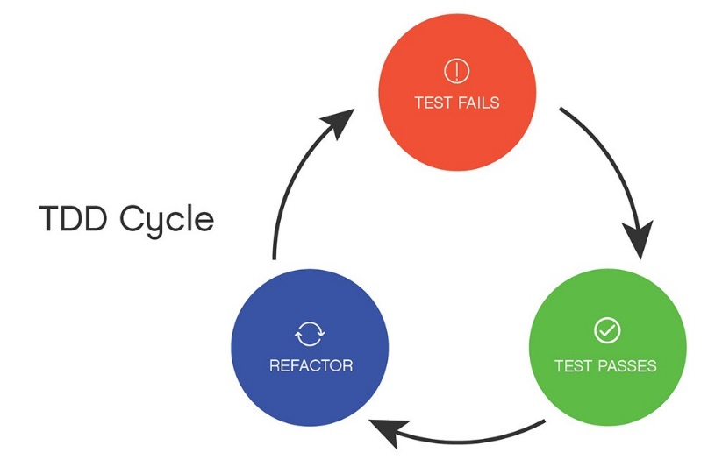
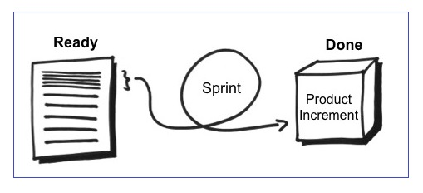





Considerações Finais
PRODUCT BACKLOG
Métricas e acompanhamento

Slide 4
Confluence B3

Slide 5
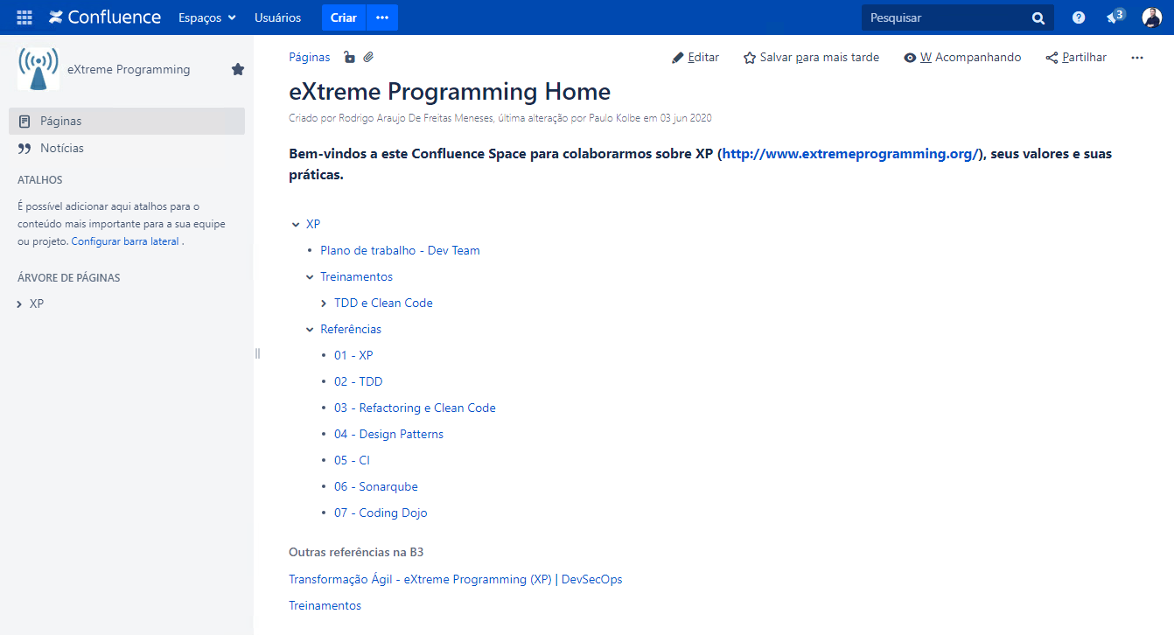
CONFLUENCE B3
XP Home: https://confluence.intraservice.corp/x/Pxy1Gw

Slide 6
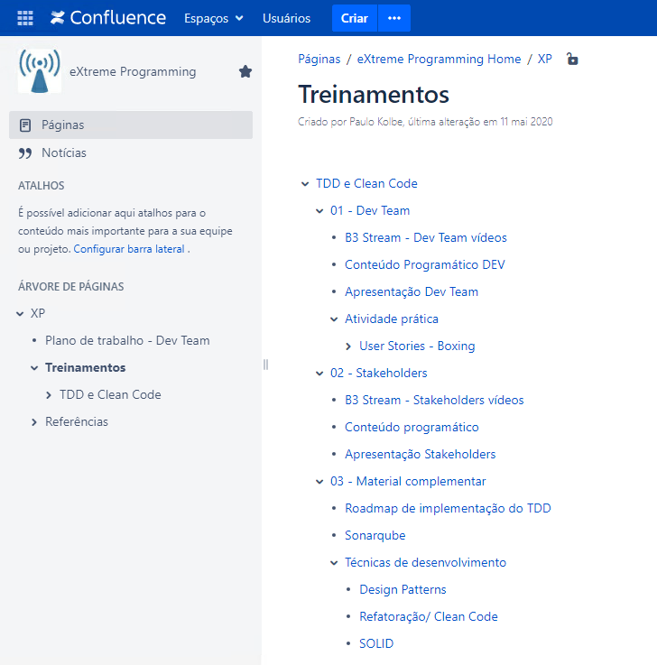
CONFLUENCE B3
Treinamentos: https://confluence.intraservice.corp/x/pCC1Gw

Slide 7


CONFLUENCE B3
Stakeholders: https://confluence.intraservice.corp/x/rCC1Gw
Dev Team: https://confluence.intraservice.corp/x/qiC1Gw
Material complementar: https://confluence.intraservice.corp/x/wCC1Gw

Slide 8


Treinamento Stakeholders prestador-paulo.kolbe@b3.com.br/ paulo.kolbe@gft.com

